Slide 1
Introduction to Microsoft PROSE SDK - Rajeev Gupta & Aditi Bhatnagar

Slide 2

Programming by Examples (PBE)
The task of synthesizing a program in an underlying domain-specific language (DSL) from example-based specification using a search algorithm.
An old problem but enabled today by
better algorithms & faster machines.
The new programming revolution
Enables 10-100x productivity for programmers.
The new computer user experience
99% users can’t program and struggle with repetitive tasks.
Non-programmers can now create scripts & achieve more.

Slide 3

Programming-by-Examples Architecture
Example-based Intent
Program set
(a sub-DSL of D)
Program
Synthesizer
DSL D
3

Slide 4
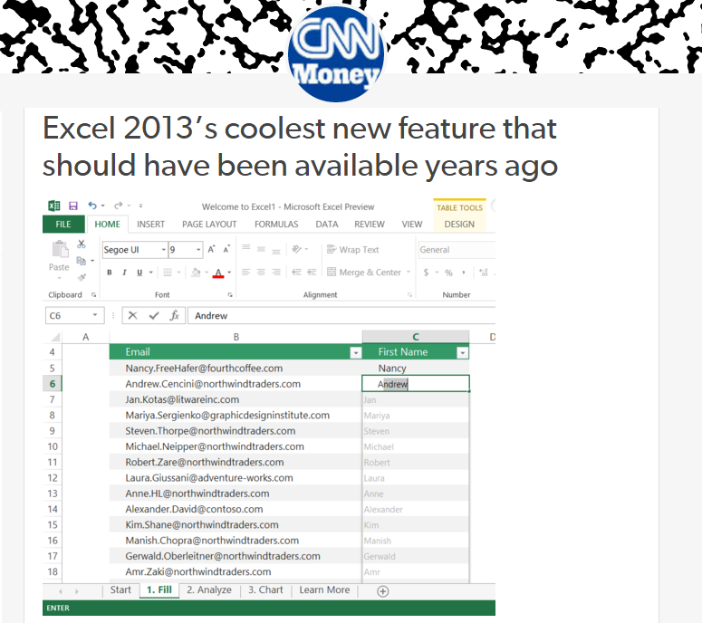
Flash Fill (Excel 2013 feature)
“Automating string processing in spreadsheets using input-output examples”;
POPL 2011; Sumit Gulwani
Notes:
Add some more examples: real demo of excel

Slide 5
Lookup Transformations
Id | Name | Markup
S33 | Stroller | 30%
B56 | Bib | 45%
D32 | Diapers | 35%
W98 | Wipes | 40%
A46 | Aspirator | 30%
... | .... | ...
Id | Date | Price
S33 | 12/2010 | $145.67
S33 | 11/2010 | $142.38
B56 | 12/2010 | $3.56
D32 | 1/2011 | $21.45
W98 | 4/2009 | $5.12
... | ... | ...
MarkupRec
Table
CostRec
Table
Input v1 (Name) | Input v2 (Date) | Output (Price+ Markup*Price)
Stroller | 10/12/2010 | $145.67+0.30*145.67
Bib | 23/12/2010 | $3.56+0.45*3.56
Diapers | 21/1/2011
Wipes | 2/4/2009
Aspirator | 23/2/2010
Learning Semantic String Transformations from Examples; VLDB 2012; Singh, Gulwani

Slide 6
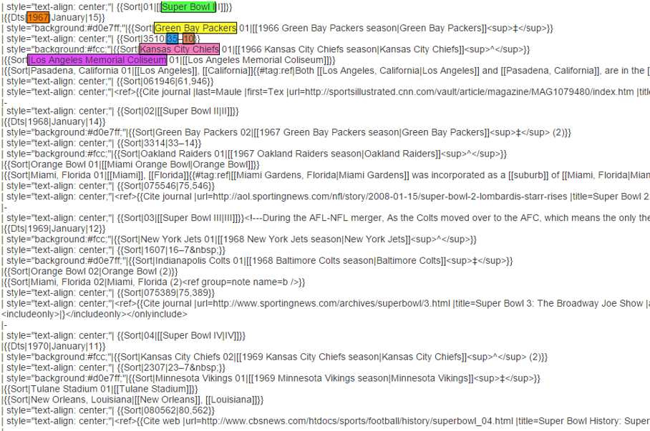
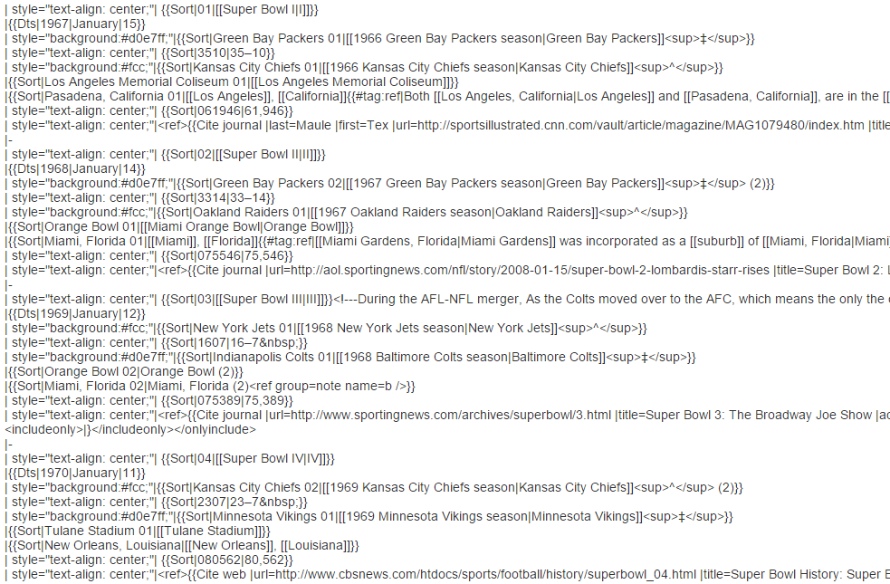
FlashExtract

Slide 7
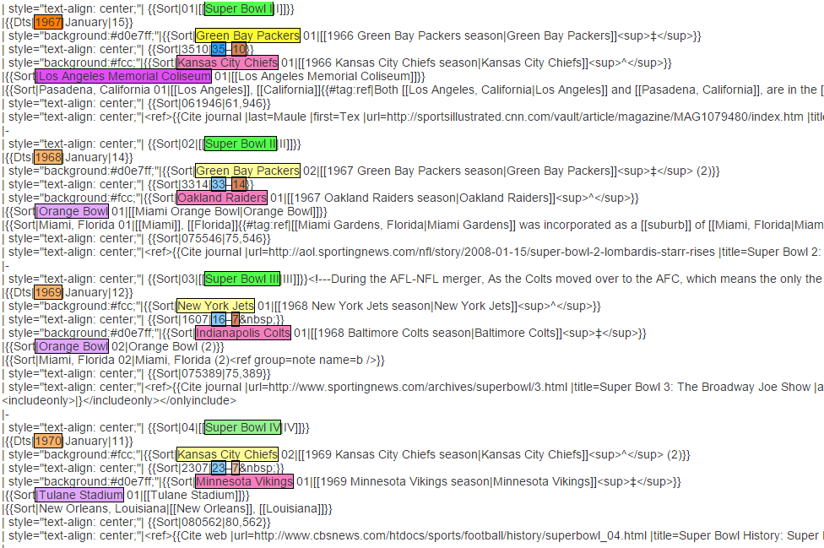
FlashExtract

Slide 8
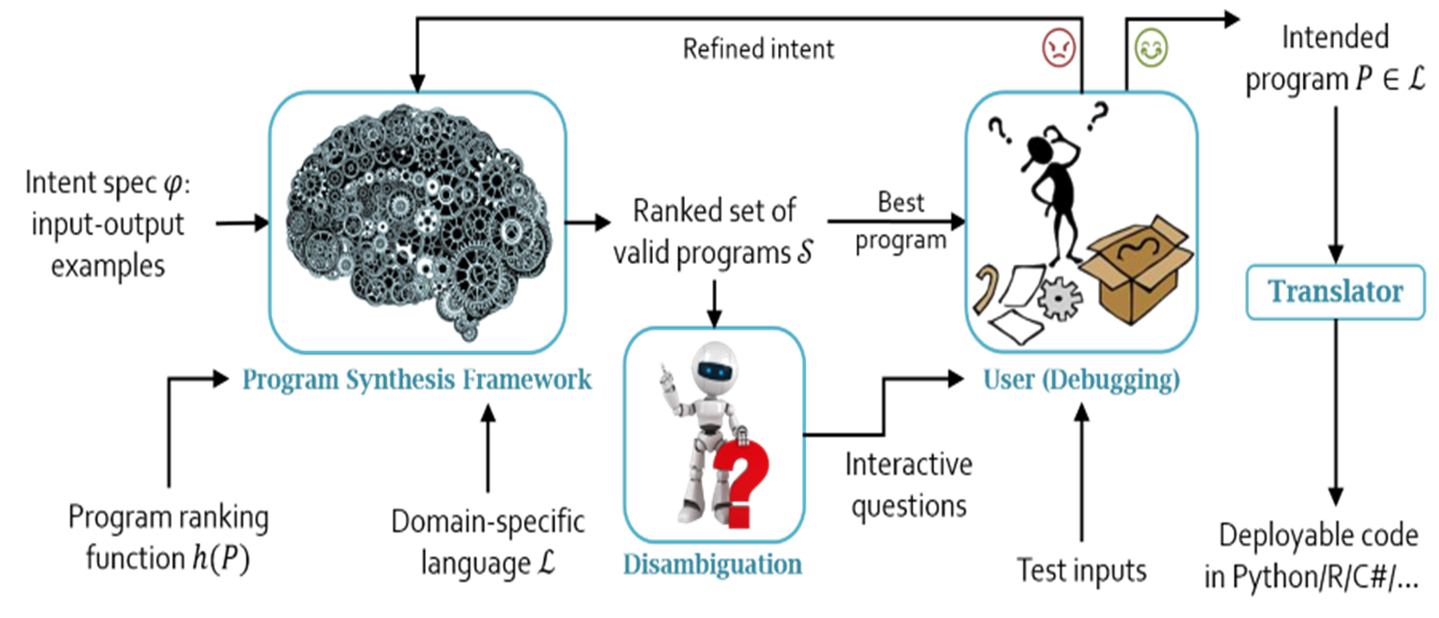
How PROSE works?

Slide 9
PROSE (https://microsoft.github.io/prose/)
Data-driven domain-specific deduction (D4 ), unifying the strengths of deductive, syntax-guided, and domain-specific inductive approaches in one meta-algorithm.
The core component of the PROSE SDK is its program synthesis framework for custom domain-specific languages (DSLs).
Text extractions, splitting & transformation
JSON extractions & transformation
Web extractions, etc.
One can define a DSL that describes a typical space of tasks in your application domain, and automatically provides parsing, execution, and synthesis technologies for this DSL.

Slide 10
Domain Specific Language
A DSL consists of four main components:
Syntax – a context-free grammar describing a space of possible programs in a DSL.
Semantics – an executable function for each user-defined DSL operator.
Features – computed attributes on individual programs in the DSL (for instance, a syntactic score of a program for ranking purposes).
Witness functions – small “inverse semantics” functions that enable deductive backpropagation, the main synthesis technology provided in the PROSE framework.

Slide 11
Example DSL
A DSL describes a space of programs that extract a substring from a given string.
They can do it in two possible ways
extract a substring based on absolute position indices
based on matches of regular expressions.
First 5 characters:
Substring(x, PositionPair(AbsolutePosition(x, 0), AbsolutePosition(x, 5)))
String between the first pair of parentheses:
Substring(x, PositionPair(RegexPosition(x, RegexPair(/\(/, //), 0), RegexPosition(x, RegexPair(//, /\)/), 0)))

Slide 12
Example grammar (substring.grammar)
#reference 'file:SubstringExtraction.dll';
using semantics SubstringExtraction.Semantics;
language SubstringExtraction;
@input string x;
@complete feature double score = RankingScore;
// Extract a substring from 'x' between positions 'posPair'
@start string out := Substring(x, pos, pos);
int? pos := AbsolutePosition(x, k) | RegexPosition(x, r, r, k);
Regex r;
int k;

Slide 13
Semantics (SubstringExtraction.Semantics)
using System.Collections.Generic;
using System.Linq;
using System.Text.RegularExpressions;
static class Semantics
{
static string Substring(string x, Tuple<int?, int?> posPair)
{
if (posPair.Item1 == null || posPair.Item2 == null)
return null;
int start = posPair.Item1.Value;
int end = posPair.Item2.Value;
if (start < 0 || start >= x.Length ||
end < 0 || end >= x.Length || end < start)
return null;
return x.Substring(start, end - start);
}
static int? AbsolutePosition(string x, int k)
{
if (k > x.Length || k < -x.Length - 1)
return null;
return k >= 0 ? k : (x.Length + k + 1);
}
static int? RegexPosition(string x, Tuple<Regex, Regex> regexPair, int occurrence)
{
if (regexPair.Item1 == null || regexPair.Item2 == null)
return null;
Regex left = regexPair.Item1;
Regex right = regexPair.Item2;
var rightMatches = right.Matches(x).Cast<Match>().ToDictionary(m => m.Index);
var matchPositions = new List<int>();
foreach (Match m in left.Matches(x))
{
if (rightMatches.ContainsKey(m.Index + m.Length))
matchPositions.Add(m.Index + m.Length);
}
if (occurrence >= matchPositions.Count ||
occurrence < -matchPositions.Count)
return null;
return occurrence >= 0
? matchPositions[occurrence]
: matchPositions[matchPositions.Count + occurrence];
}
}

Slide 14
Witness functions
For each operator and for each of its parameters, provide a witness function
possibly conditioned on some other parameters
describing the constraints on that parameter given a constraint on its output (in a given input state).
A witness function takes as input a specification on the output
of the entire operator expression,
and outputs a specification on the output of one parameter
in that expression.

Slide 15
Example witness function
[WitnessFunction("AbsolutePosition", 1)
DisjunctiveExamplesSpec WitnessK(GrammarRule rule, DisjunctiveExamplesSpec spec)
{
var result = new Dictionary<State, IEnumerable<object>>();
foreach (var example in spec.DisjunctiveExamples)
{
State inputState = example.Key;
var ks = new HashSet<int?>();
var x = (string) inputState[rule.Body[0]];
foreach (int? pos in example.Value)
{
ks.Add(pos);
ks.Add(pos - x.Length - 1);
}
if (ks.Count == 0) return null;
result[inputState] = ks.Cast<object>();
}
return new DisjunctiveExamplesSpec(result);
}

Slide 16
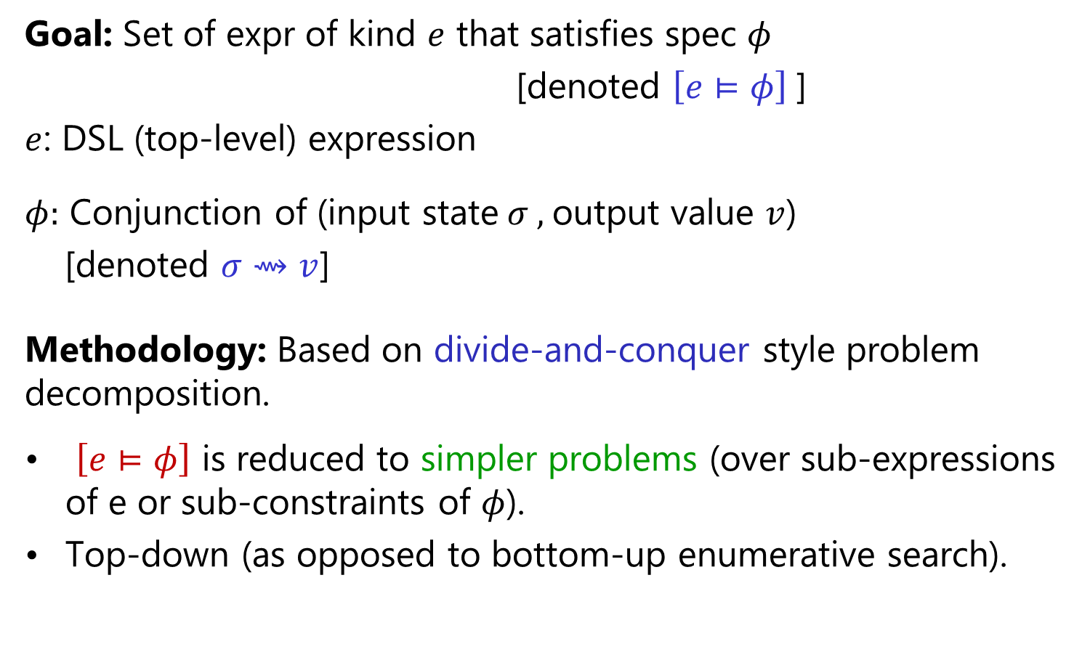
Search Methodology
Goal: Set of expr of kind $e$ that satisfies spec $φ$
[denoted $\left[e⊨φ\right]$]
$e$: DSL (top-level) expression
$φ:$ Conjunction of (input state$σ ,$output value $v$)
[denoted $σ⇝v$]
Methodology: Based on divide-and-conquer style problem decomposition.
$\left[e⊨φ\right]$ is reduced to simpler problems (over sub-expressions of e or sub-constraints of $φ$).
Top-down (as opposed to bottom-up enumerative search).
“FlashMeta: A Framework for Inductive Program Synthesis”;
[OOPSLA 2015] Alex Polozov, Sumit Gulwani

Slide 17

Basic ranking scheme
Prefer programs with simpler Kolmogorov complexity
Prefer fewer constants.
Prefer smaller constants.
Input | Output
Amey Modi | Amey
Ravindra Jadeja | Ravindra
1st Word
If (input = “Amey Modi”) then “Amey” else “Ravindra”

Slide 18
Challenges with Basic ranking scheme
Prefer programs with simpler Kolmogorov complexity
Prefer fewer constants.
Prefer smaller constants.
Input | Output
Amey Modi | Modi, Amey
Ravindra Jadeja | Jadeja, Ravindra
2nd Word + “, ‘’ + 1st Word
“Modi, Amey”
How to select between
Fewer larger constants vs. More smaller constants?
Idea: Associate numeric weights with constants.
Predicting a correct program in Programming by Example; CAV 2015; Singh, Gulwani

Slide 19
Example ranking scores
[FeatureCalculator(nameof(Semantics.Substring))]
public static double Substring(double v, double start, double end) => start * end;
[FeatureCalculator(nameof(Semantics.AbsPos))]
public static double AbsPos(double v, double k) => k;
[FeatureCalculator("k", Method = CalculationMethod.FromLiteral)]
public static double K(int k) => 1.0 / (Math.Abs(k)+1);
[FeatureCalculator(nameof(Semantics.RelPos))]
public static double RelPos(double x, double rr) => rr;
[FeatureCalculator("rr", Method = CalculationMethod.FromLiteral)]
public static double RR(Regex, Regex) => 1;

Slide 20
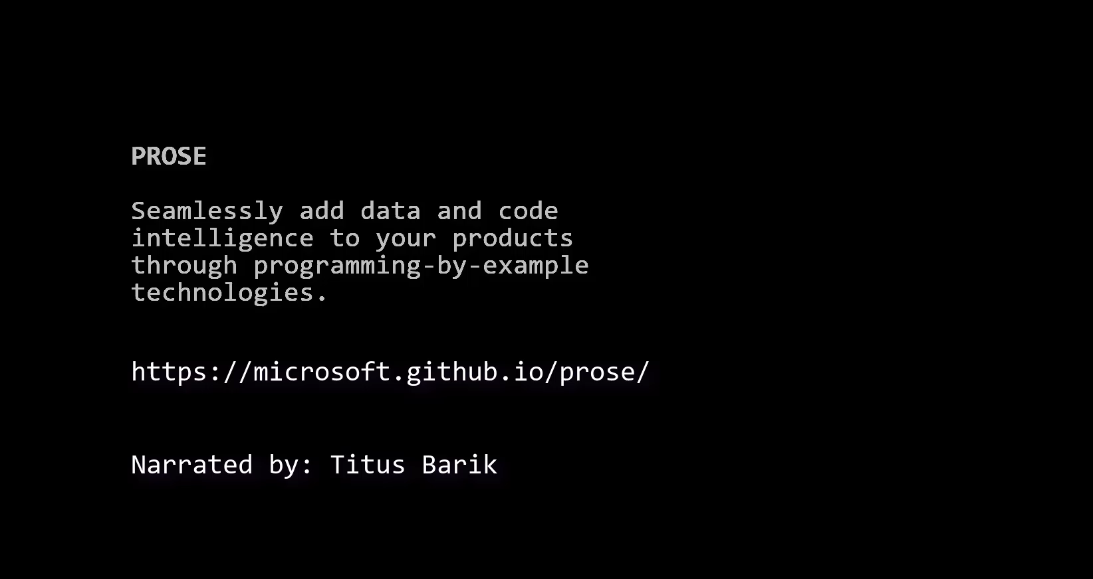
PROSE capabilities

Slide 21
Tech Challenge – AI with Machine Reading Comprehension
Theme 1: Learn the Text book – Make use of AI to read and learn from text books available in digital format. Use the learning to help solve some common queries. E.g. – Among a set of Algorithm books, which one explains NP algorithm in the best way.
Theme 2: Legal consultant – Make use of AI to comprehend a given legal document and answer specific queries related to it. E.g. – Read a legal policy document and its Terms & conditions and highlight important points that need attention or answer specific queries related to the policy.
Theme 3: Breaking news – Make use of AI to collate events from multiple news bytes, understand and identify a breaking news out of it. E.g. – Read cricinfo commentary of an ongoing match and identify if an event can change the outcome of the game, notify the same to users or gather news and sentiments of a newly released movie and detect if it can be a potential hit, thus, suggest users to watch it.

Slide 22
Resources
Documentation
https://microsoft.github.io/prose/
Code
https://github.com/gustavoasoares/prose-tutorial/wiki/Prose-tutorial
https://github.com/jimishbhayani/mrc-with-prose
Word Add In
https://github.com/nextLane/PROSEWordPlugin
Demo App
https://github.com/gustavoasoares/prose-tutorial/tree/master/ProseTutorialApp

